Slide 1

CS415: Databases

Slide 2
Lesson 6
Database Application Programming: Node.JS and MySQL

Slide 3
Wholeness
This lecture focuses on how to develop a database application program, using JavaScript and node.js with the MySQL database.
The Science of Consciousness theme is: Rest and activity are the natural steps of progress.

Slide 4
1.1 Overview
Essential components:
Node.JS and npm
MySQL database
The node.js database driver for MySQL, written in JavaScript and is named, mysql.
JavaScript Code Editor or IDE e.g. Visual Studio Code

Slide 5
1.2 Introduction to MySQL
MySQL is an open-source relational database management system (RDBMS)
In this course we will be studying and implementing the various Database Management system concepts and techniques using a MySQL instance
Therefore, you are required to download and install a MySQL Database server on your local machine (if you do not already have it).*
MySQL can be obtained from https://dev.mysql.com/
*Note: A demonstration of how to obtain and install MySQL will be given.

Slide 6
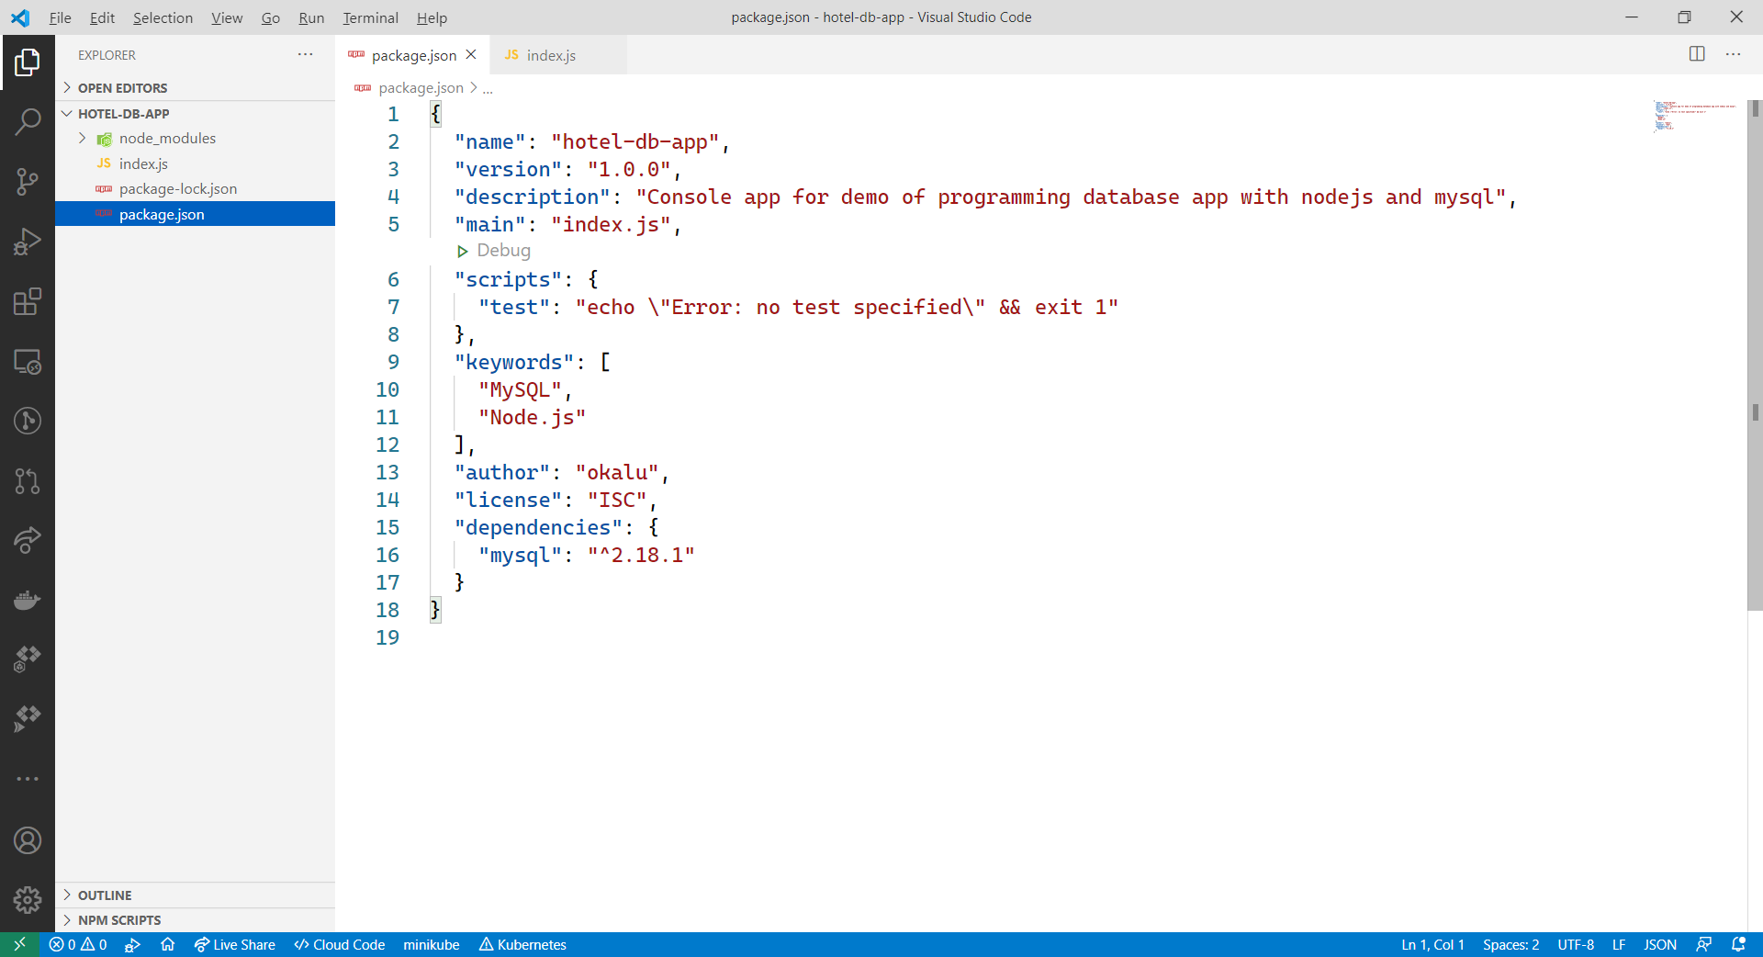
1.2 Demo – hotel-db-app

Slide 7
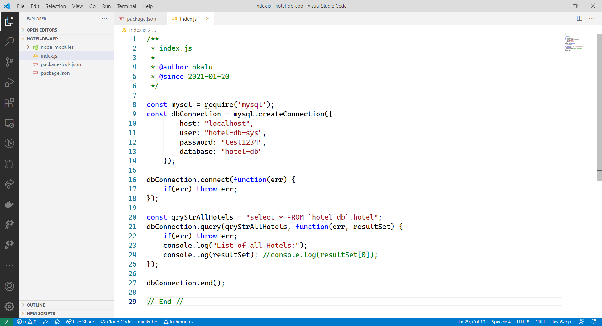
1.2 Demo – hotel-db-app

Slide 8
Main Point
Developing a data-driven application typically requires a piece of middleware, which serves as a bridge between the application code and the database management system. For MySQL, this is the mysql database driver. A version implemented in JavaScript for the Node.JS runtime environment is obtainable from the npm repository. Knowledge is different in different states of consciousness.

Slide 9
Connecting the Parts of Knowledge With the Wholeness of Knowledge
Overview and Introduction of Databases and DBMSs
1. A Database application, otherwise known as a Data-driven application is an application that interacts with data stored in a database hosted by a DBMS.
2. Developing such an application typically requires a Database Driver, which is specialized system software (middleware) for enabling connection to the database and executing SQL commands.
___________________________________________________________
3. Transcendental consciousness is the underlying basis of all levels of creation.
4. Impulses within the Transcendental Field: A well-designed Database which forms the basis of an elegant software solution, arises as an impulse of the Transcendental Field.
5. Wholeness moving within itself: In Unity Consciousness, one directly perceives that all expressions and levels of creation are nothing more than one’s own Self – pure consciousness.

Slide 10
CS418: Databases & Software Development

